Slide 1
Revisiting the Uniqueness of Simple Demographics
in the US Population
Aditya Shirode
Kushan Kunal Prasad

Slide 2
OVERVIEW OF TOPIC
Revisiting and comparing results of 2000 Census to 2010 Census
87% (1990) vs 63%(2000) vs ? (2010)
Based on three attributes - Gender, Age, Location

Slide 3
RESEARCH QUESTIONS
Finding anonymity value for US population given following - {Gender, Age/DOB, Location}
Calculating the change in the amount of threat to privacy posed by the disclosure of simple demographic information

Slide 4
MOTIVATION
Sweeney Paper observing 1990 census was one of the most influential discoveries in Re-identification
New techniques have been designed to prevent/avoid reidentification
Updating the results and verifying impact of current “Best Practices”

Slide 5
APPROACH
Gather census data corresponding to required attributes with different levels of granularity
Calculate anonymity value for the dataset
Compare and contrast results

Slide 6
APPROACH (Contd.)
Granularity Levels - ZipCode and County
Calculating DoBs by assuming that births are uniformly distributed across the days of the year

Slide 7
ABOUT THE DATABASE
Table PCT12 - Age by Gender, Ethnicity
Male/ Female - 0:99,100-104,105-109,110+
Summarized to Census Tract Level
Notes:
Data file segment number - 17 Number of data cells - 209
http://proximityone.com/m2/m2guide/
http://proximityone.com/zip-place.htm

Slide 8
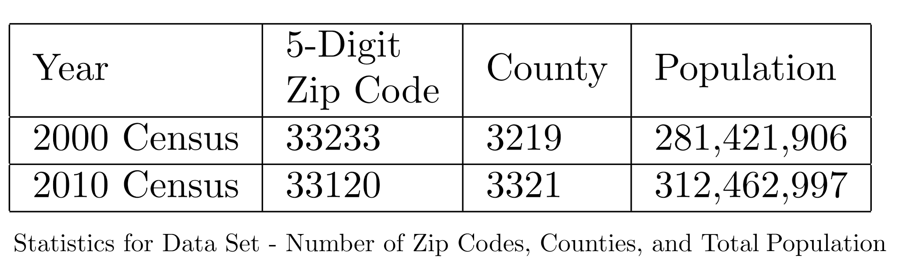
DIFFERENCES BETWEEN 2000 AND 2010
Notes:
Cover the full extent of the nation - "wall-to-wall" coverage vs Do not cover the full extent of the nation - "holes" exist
11.03% Population Increase

Slide 9
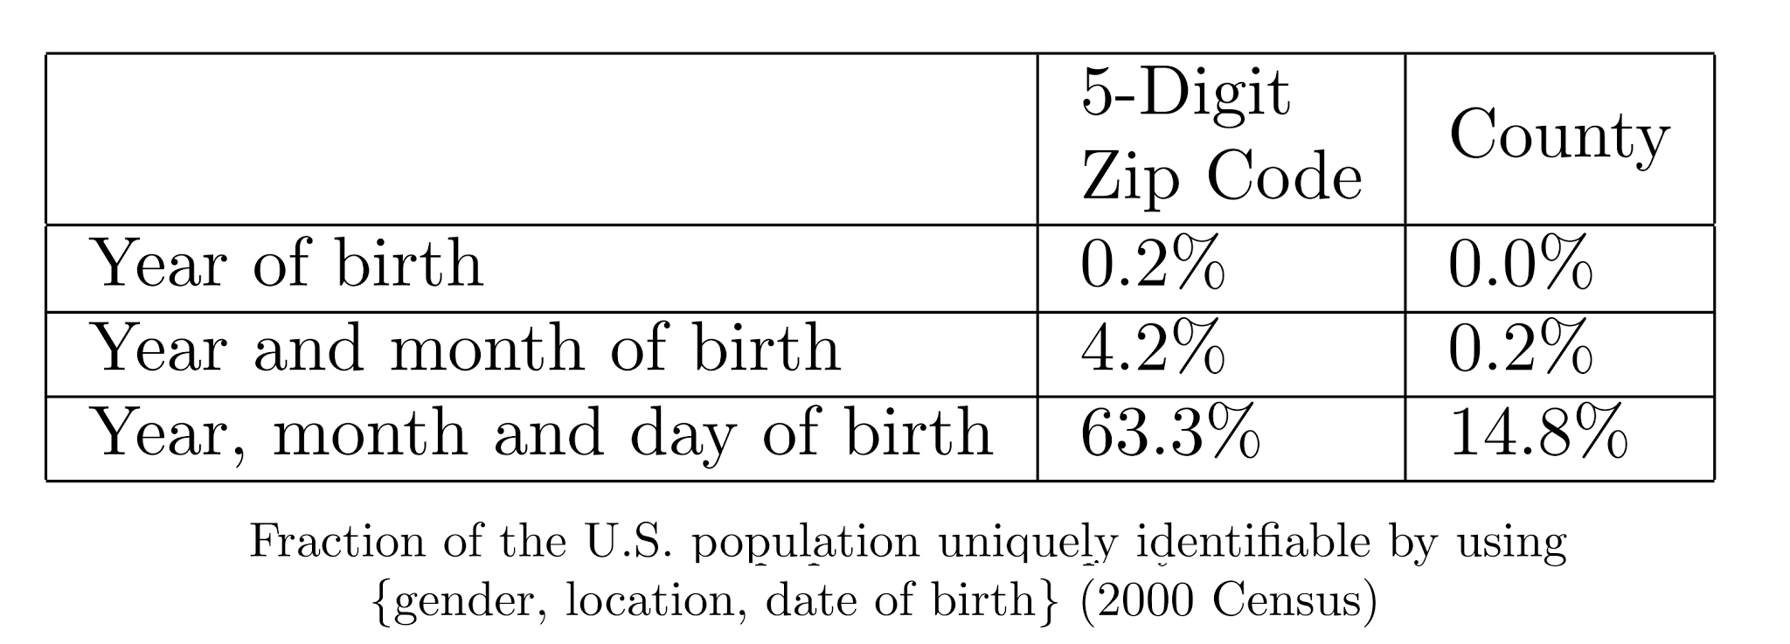
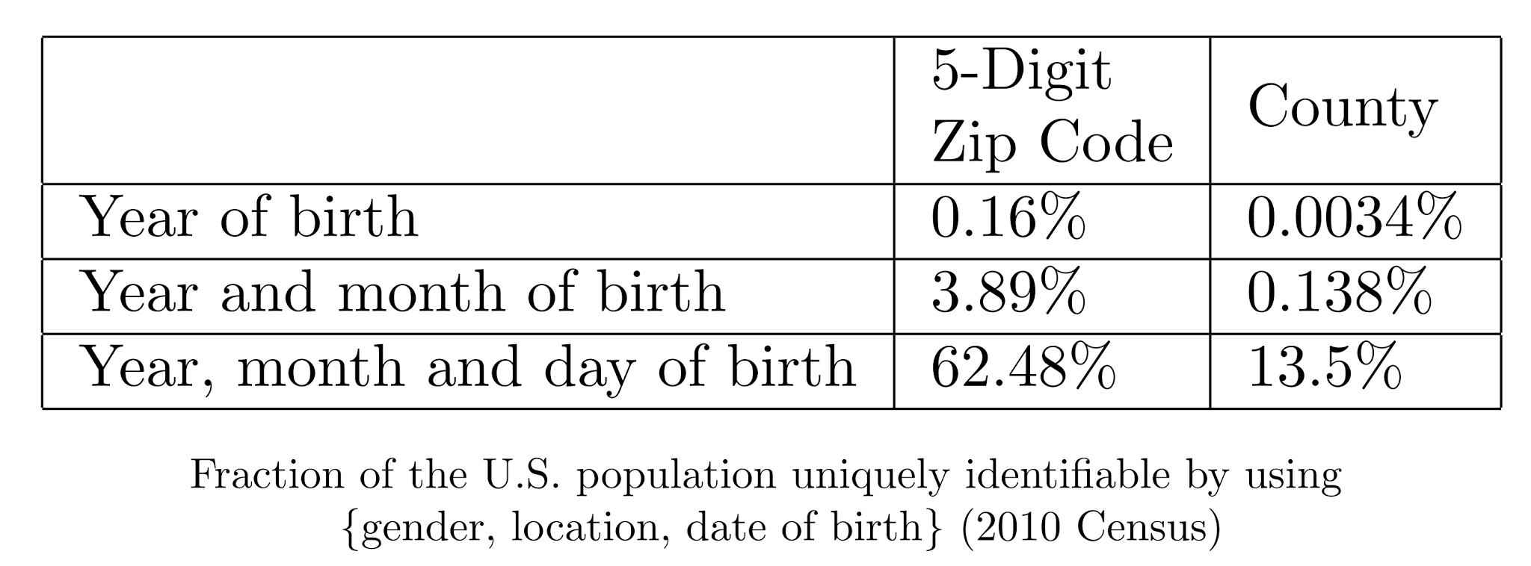
RESULTS

Slide 10
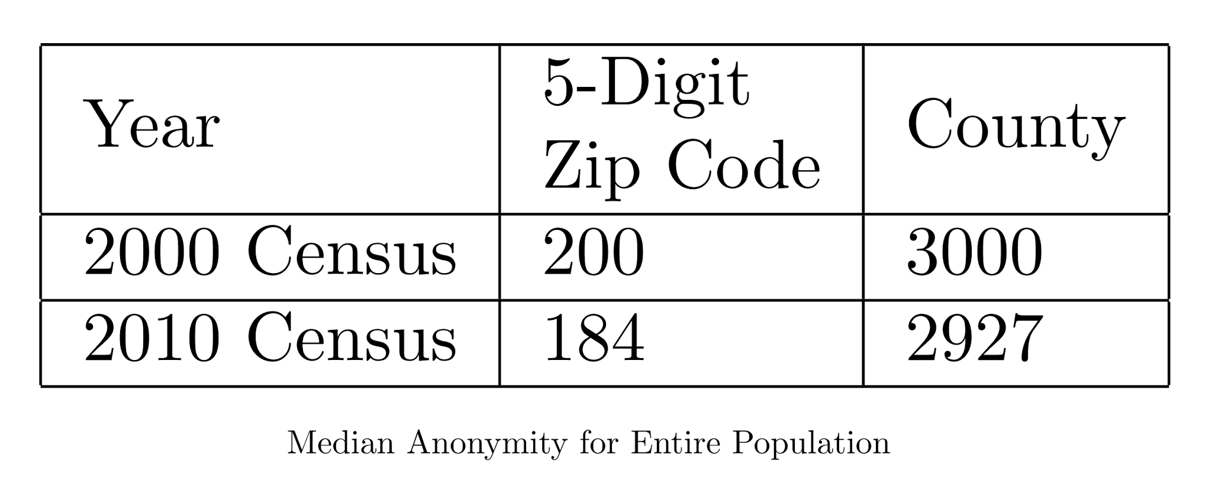
RESULTS
Note: When we calculated the median on the 2000 census data we got the values 166 and 2515 for Zip Code and County respectively.
Notes:
Actual Median Anonymity for 2000 Census - 166,2515

Slide 11
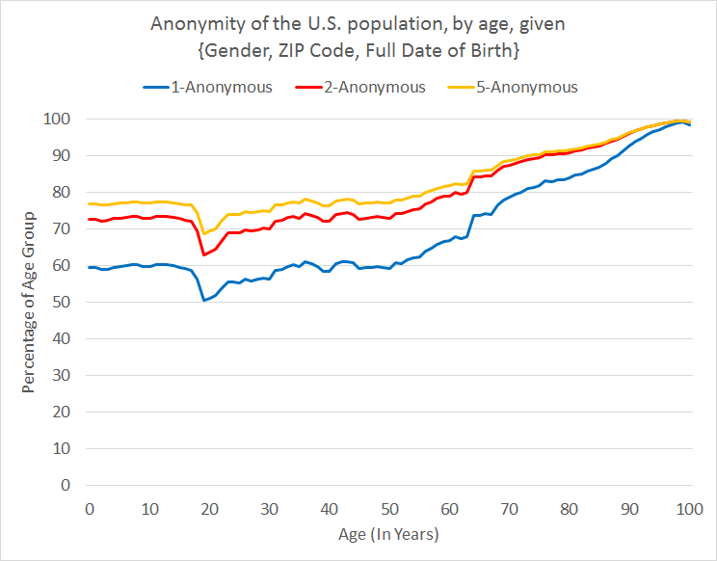
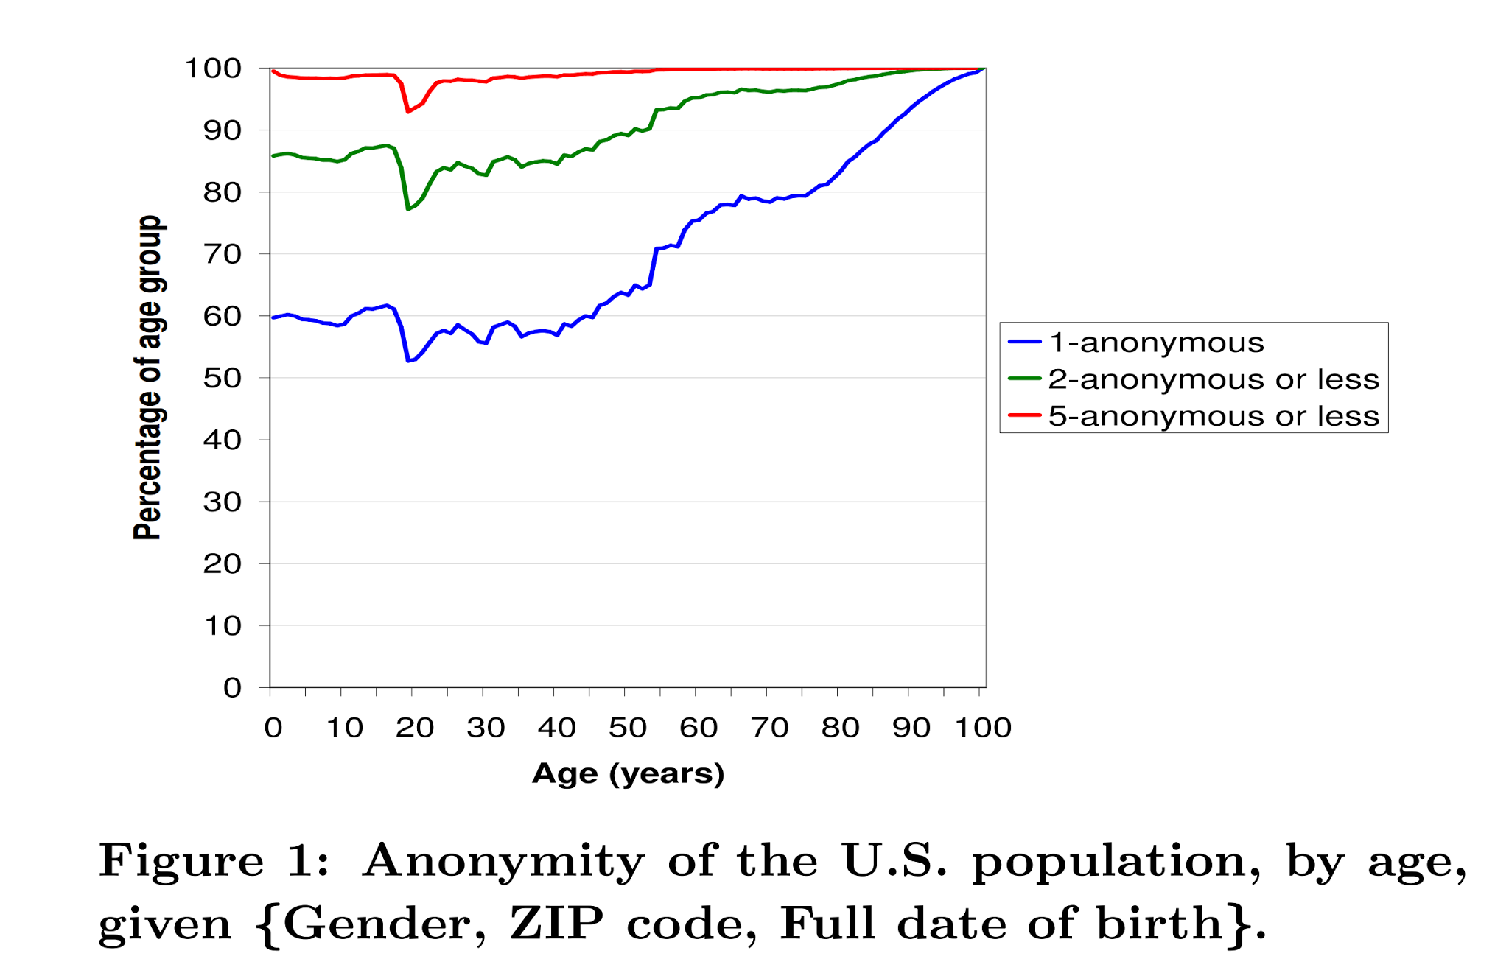
RESULTS
2000 2010

Slide 12
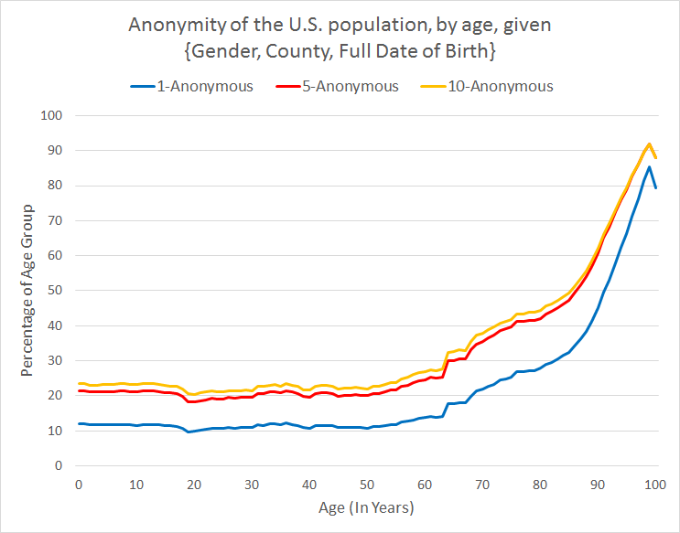
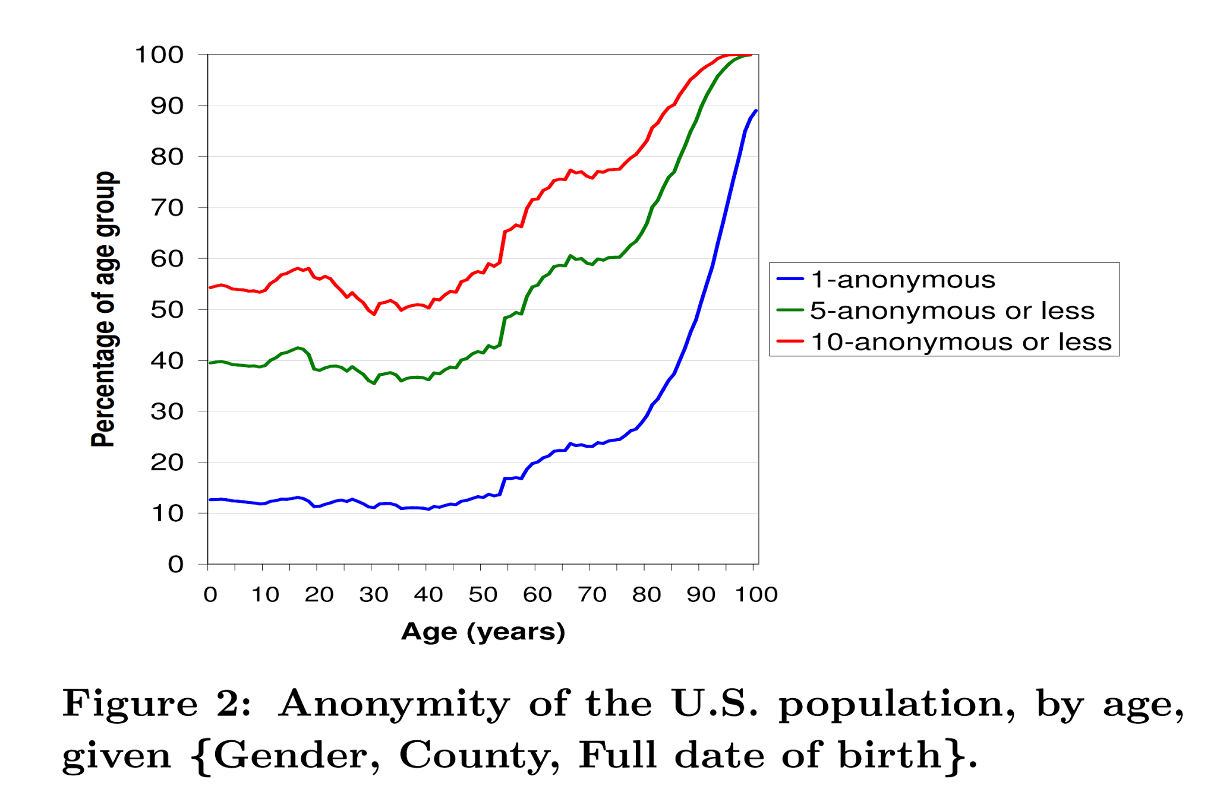
RESULTS
2000 2010

Slide 13
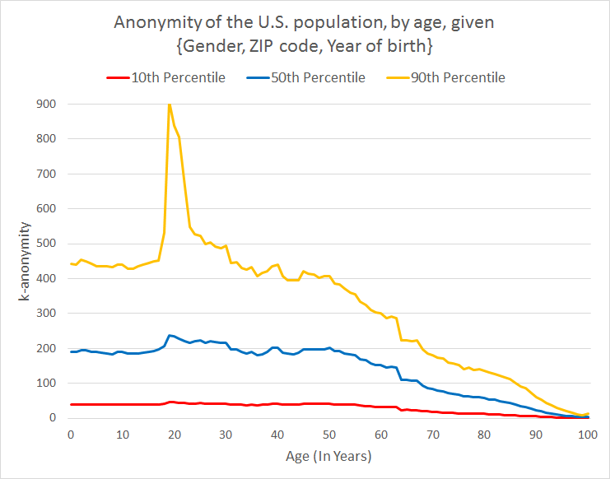
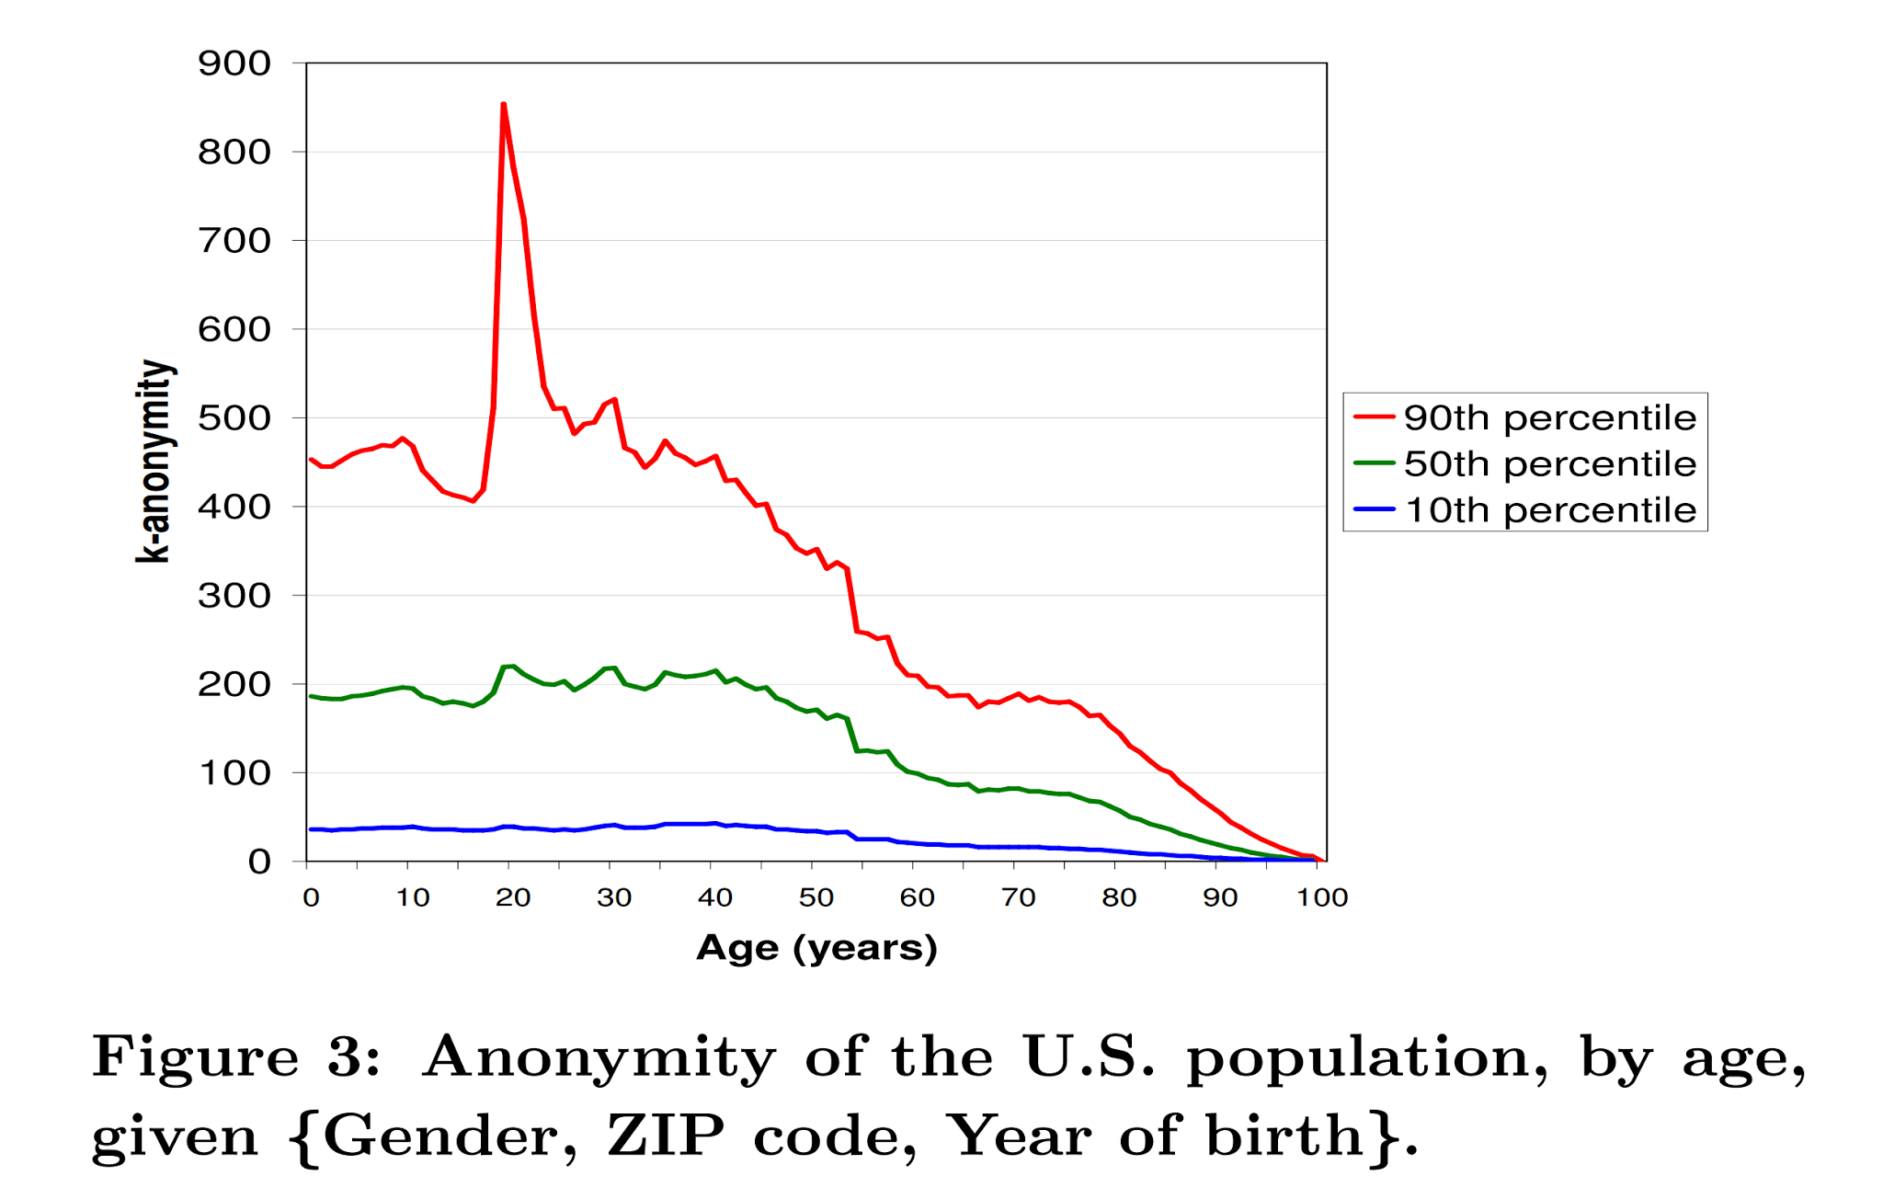
RESULTS
2000 2010

Slide 14
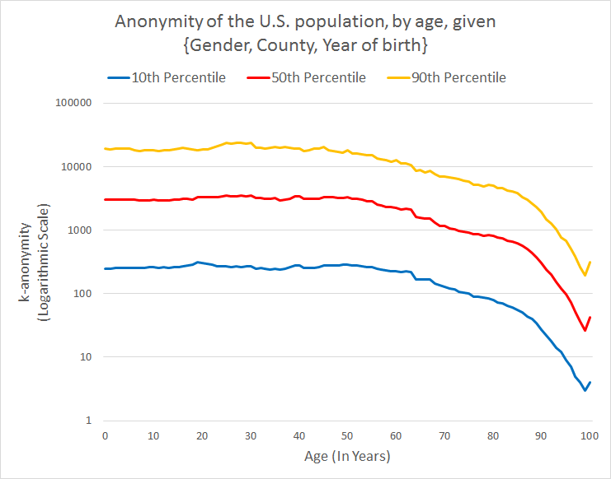
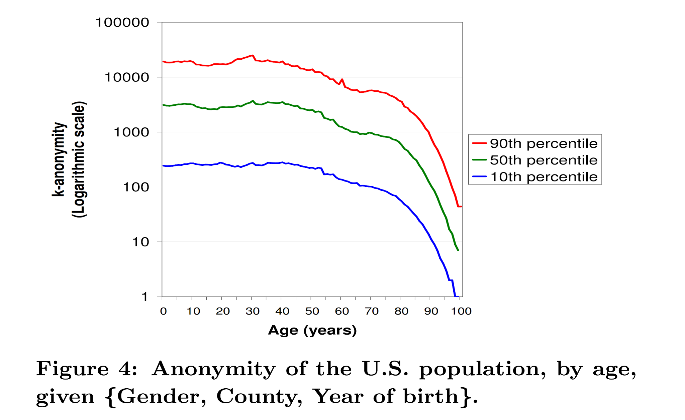
RESULTS
2000 2010

Slide 15
OTHER OBSERVATIONS
Top #3 Entries with Highest Anonymity -
Highest anonymity for the Wolfpack
For Male- Age:19 Anonymity:1757
For Female- Age:19 Anonymity:1714
Age | Gender | ZipCode | Anonymity
19 | F | 77840 | 4498
19 | M | 77840 | 4084
20 | F | 77840 | 3908
Notes:
Age, Gender, Zip Code, Location, k-anonymity value
Top #3 most anonymous zip codes
77840 TAMU 47906 Purdue 32304 U of Washington
All for ages 19-21

Slide 16
OTHER OBSERVATIONS
Top #3 Zip Codes with highest Anonymity
Rank | 2000 | 2010
1 | College Station, TX | College Station, TX
2 | West Lafayette, IN | West Lafayette, IN
3 | Austin, TX | Tallahassee, FL*

Slide 17
LIMITATIONS
Date of Birth decided assuming Uniform Distribution
Tough to verify the k-anonymity value practically
Needs constant comparison with updated data (Year round census)

Slide 18
CONCLUSION
63% of US Population uniquely identifiable based on data from recent 2010 Census
Proves that release conditions of simple demographics still require improvement

Slide 19
LESSONS LEARNED
Verify that you are working on correct data set (Always!)
Java is not the best choice to work on large amount of data

Slide 20
FUTURE WORK
Comparing results with census from other Countries
Incorporating real-world data for actual re-identification

Slide 21
APPENDIX
http://www.census.gov/data/developers/data-sets/decennial-census-data.html
API to access Census Data
Planning to test for Differential Privacy Features

Slide 22
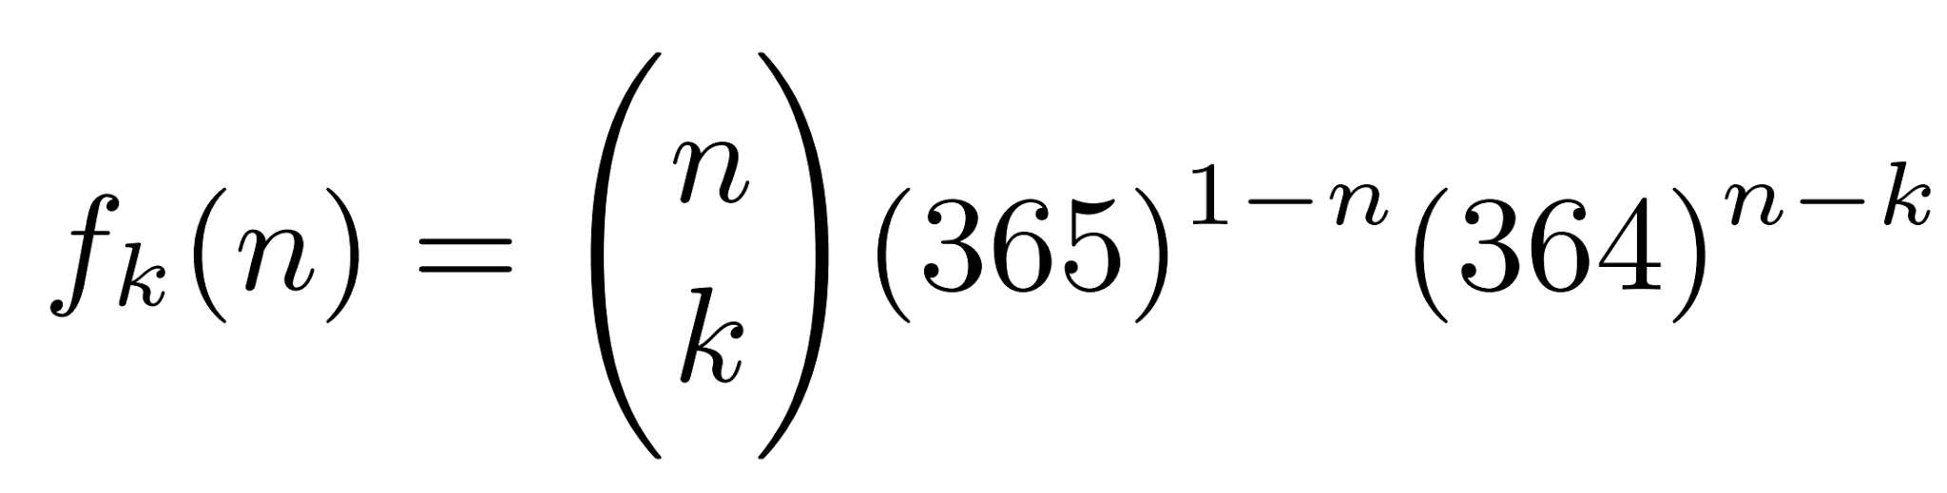
APPENDIX
Formula to calculate Date of Birth

Slide 23
THANK YOU

